Slide 1
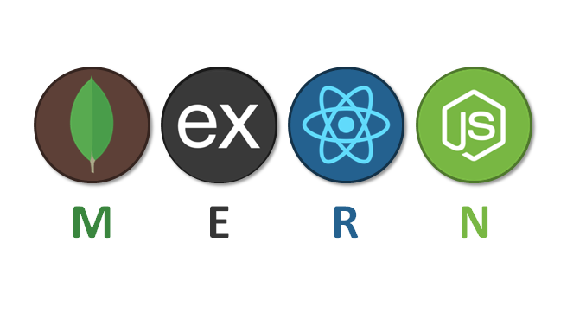
MERN Stack Development
Ritik Dwivedi

Slide 2

React

Slide 3
Topics
Introduction to React
Features
Imperative VS Declarative Approach
Node Modules
Package JSON
Basic Structure
Components
Props
State

Slide 4
Conditional Rendering
Process of Rendering
Life Cycle Methods
Hooks
Custom Hooks
React Router
Redux Toolkit

Slide 5
Intro
React is a JavaScript library for building user interfaces.
React is used to build single-page applications, meaning the website's content changes without reloading the entire webpage.
React allows us to create reusable UI components.

Slide 6
Features

Slide 7
JSX(JavaScript Syntax Extension)
React uses the JSX format. It is a combination of HTML and JavaScript. We can embed JavaScript objects inside the HTML elements. JSX makes codes easy and understandable.
const name="GeekforGeeks";
const ele = <h1>Welcome to {name}</h1>;

Slide 8
Virtual DOM
Virtual DOM Concept: React uses a Virtual DOM, which is a lightweight copy of the real DOM.
Modification Handling: Whenever there is a modification in the web application, React updates the Virtual DOM first.
Reconciliation Process: React compares the current Virtual DOM with the previous version using a process called "reconciliation" to identify the differences.
Identifying Differences: Once it finds the differences (or "diffs"), React updates only the parts of the real DOM that have changed.
Efficiency: This selective updating process makes React applications fast and efficient.

Slide 9
Components
React.js divides the web page into multiple components as it is component-based. So the component logic which is written in JavaScript makes it easy and run faster and can be reusable.

Slide 10
Performance
As we discussed earlier, react uses virtual DOM and updates only the modified parts. So , this makes the DOM to run faster. DOM executes in memory so we can create separate components which makes the DOM run faster.

Slide 11
Imperative VS Declarative Approach

Slide 12
In the imperative approach, developers explicitly instruct the browser how to update the UI by directly manipulating the DOM using JavaScript commands. This approach requires detailed steps and explicit control over DOM elements.
On the other hand, in the declarative approach adopted by frameworks like React, developers focus on what the UI should look like, describing UI components and their states without specifying the update process. The framework automatically handles rendering and updating the DOM based on changes in data or state.

Slide 13
const items = ['Item 1', 'Item 2', 'Item 3'];
const App = () => (
<ul>
{items.map(item => (
<li key={item}>{item}</li>
))}
</ul>
);

Slide 14
Node Modules

Slide 15
Node modules are reusable JavaScript libraries or packages that can be included in your project. They contain code that provides specific functionality.
Node modules are managed by package managers like npm (Node Package Manager) or Yarn.
When you install a Node module, it gets placed in the node_modules directory in your project. It contains all the code for the modules you’ve installed, along with any dependencies they require.

Slide 16
Package JSON

Slide 17
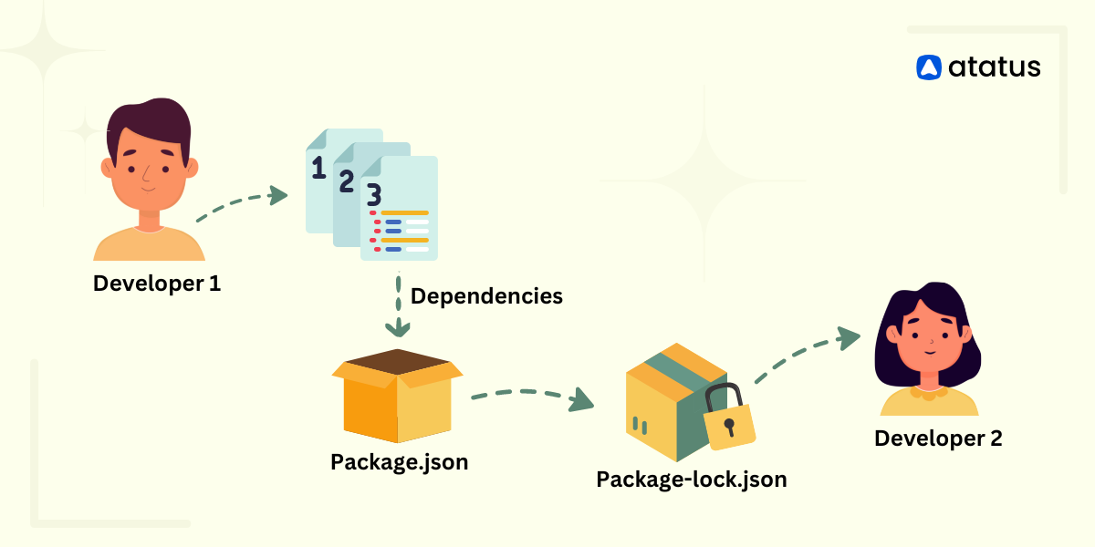
The package.json file is a key file in any Node.js project. It contains metadata about the project and is used to manage the project's dependencies, scripts, version, and other information.
package-lock.json ensures consistency and performance by locking down the exact versions of dependencies.

Slide 18
The package.json file is a key file in any Node.js project. It contains metadata about the project and is used to manage the project's dependencies, scripts, version, and other information.
package-lock.json ensures consistency and performance by locking down the exact versions of dependencies.

Slide 19
Let’s Understand the Structure of React Application

Slide 20
Components

Slide 21
React Components are reusable piece of code that used to display a specific part of the UI.
There are two main types of components in React:
Functional Components
Class Components

Slide 22
Functional components are simpler and more concise. They are just JavaScript functions that take props (properties) as an argument and return React elements.
They are also known as stateless components because they don't manage their own state.
Functional components are preferred when you only need to present UI based on the props received, without any internal state or lifecycle methods.
We usually use functional components.

Slide 23
import React from 'react';
const FunctionalComponent = (props) => {
return (
<div>
<p>{props.message}</p>
</div>
);
};
export default FunctionalComponent;

Slide 24
Class components are more feature-rich and have additional capabilities. They can manage their own local state and have lifecycle methods.
Class components are used when you need to manage state or use lifecycle methods, such as `componentDidMount`, `componentDidUpdate`, etc.
Prior to React Hooks (introduced in React 16.8), class components were the primary way to use state and lifecycle methods.

Slide 25
import React, { Component } from 'react';
class ClassComponent extends Component {
render() {
return <h1>Hello, {this.props.name}!</h1>;
}
}
export default ClassComponent;

Slide 26
Props

Slide 27
In React, "props" is short for "properties," and it refers to the mechanism by which data is passed from a parent component to its child components.

Slide 28
Component:
import React from 'react';
const Greeting = (props) => {
return <h1>Hello, {props.name}!</h1>;
};
export default Greeting;

Slide 29
import React from 'react';
import Greeting from './Greeting';
const App = () => {
return (
<div>
<Greeting name="Bob" />
</div>
);
};
export default App;

Slide 30
State

Slide 31
The state allows a component to keep track of changes in its data and triggers re-rendering when the data is updated. State is a fundamental concept in React and is often used to manage dynamic content and user interactions.
Use State: When you need the component to react to changes and re-render with new data. For example, when managing form inputs, counters, toggles, or any dynamic content.
Use Variables: For calculations, intermediate values, or any data that does not need to trigger a re-render.

Slide 32
//import state hook from react
import React, { useState } from 'react';
// Using the 'useState' hook to declare a state variable
const [count, setCount] = useState(0);

Slide 33
// Event handler to update the state
const handleIncrement = () => {
setCount(count + 1);
};
return (
<div>
<p>Count: {count}</p>
<button onClick={handleIncrement}>Increment</button>
</div>
);

Slide 34
Conditional Rendering
“Rendering” is React calling your components.

Slide 35
Conditional rendering use to rendering different content or components based on certain conditions or logic. It allows us to control what is displayed to the user depending on the state of our application.
return (
if (/* your condition here */) {
return <p>Content to render when the condition is true</p>;
} else {
return <p>Content to render when the condition is false</p>;
}
);

Slide 36
Process of Rendering

Slide 37
Triggering/ Initial Render:
When your app starts, you need to trigger the initial render. it’s done by calling createRoot with the target DOM node, and then calling its render method with your component:

Slide 38
Re-Rendering:
Whenever there is any modification in a component it triggers re-rendering.
Re-rendering can be triggered by:
State Changes
Prop Changes
Context Changes: When the values provided by a React Context change.
Force Update: When a component is forcefully updated.

Slide 39
Committing:
React will apply the minimal necessary operations (calculated while rendering!) to make the DOM match the latest rendering output.
React only changes the DOM nodes if there’s a difference between renders.

Slide 40
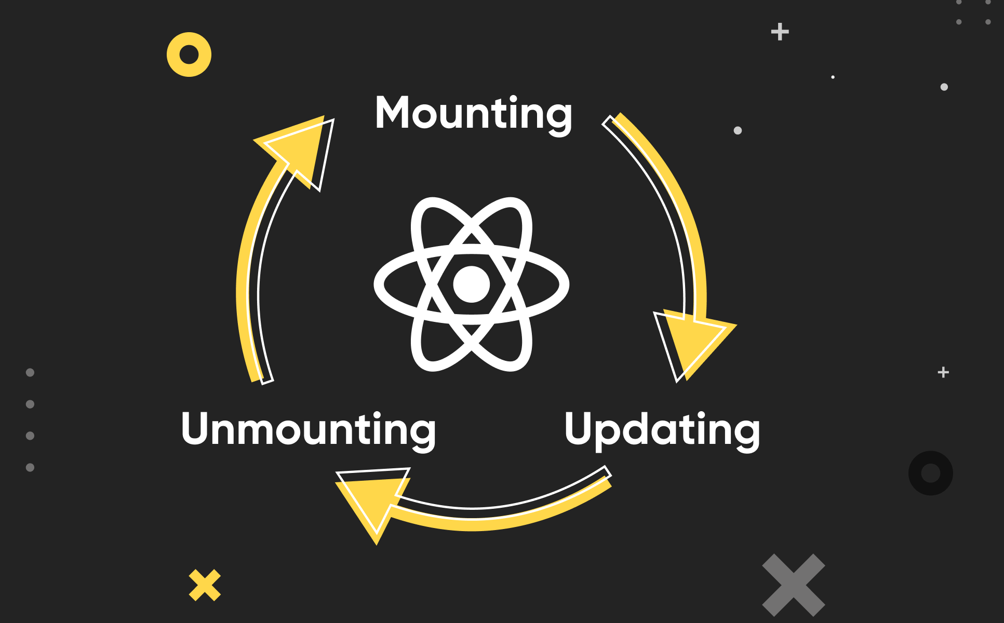
Life Cycle Methods

Slide 41
Mounting:
Mounting means putting elements into the DOM.
constructor(): This method is called before the component is mounted. It is used for initializing state and binding methods.
render(): The `render()` method is required and will always be called, the others are optional and will be called if you define them.
componentDidMount(): The `componentDidMount()` method is called after the component is rendered.

Slide 42
Updating:
The next phase in the lifecycle is when a component is *updated*.
A component is updated whenever there is a change in the component's `state` or `props`.
- shouldComponentUpdate(): This method is called before rendering when new props or state are being received. It can be used to optimize rendering by preventing unnecessary updates.
- componentDidUpdate(): This method is called after the component has been updated in the DOM.

Slide 43
Unmounting:
The next phase in the lifecycle is when a component is removed from the DOM, or unmounting as React likes to call it.
React has only one built-in method that gets called when a component is unmounted:
componentWillUnmount(): The `componentWillUnmount` method is called when the component is about to be removed from the DOM.

Slide 44
Hooks

Slide 45
React Hooks allow functional components to use state and other React features without needing to write a class.
Before the introduction of hooks, functional components were stateless and lacked the ability to use lifecycle methods or manage local component state. Hooks address these limitations and offer several advantages.

Slide 46
Hooks Rules
- Hooks can only be called inside React function components.
- Hooks cannot be conditional
- You must `import` Hooks from `react`.

Slide 47
UseEffect()
The `useEffect` hook allows us to perform side effects in our functional components.
Component lifecycle divided into three parts whenever we need to create effect during mounting, updating or unmounting phase we can create through useEffect.

Slide 48
import React, { useEffect } from 'react';
// useEffect(() => {}, []);
function MyComponent() {
useEffect(() => {
// Code inside this block will run after the component renders
// Cleanup code (if needed)
return () => {
};
}, [dependency1, dependency2]);
}

Slide 49
UseRef:
It can be used to store a mutable value that does not cause a re-render when updated.
The `useRef` Hook allows you to persist values between renders.
`useRef()` only returns one item. It returns an Object called `current`. This current object is used for direct changes in dom.

Slide 50
import React, { useRef } from 'react';
function Component() {
// Creating a ref object
const myRef = useRef(initialValue);
// Usage example: accessing current value
console.log(myRef.current);
return (
<div>
{/* Example of using the ref */}
<input ref={myRef} type="text" />
</div>
);
}

Slide 51
useContext

Slide 52
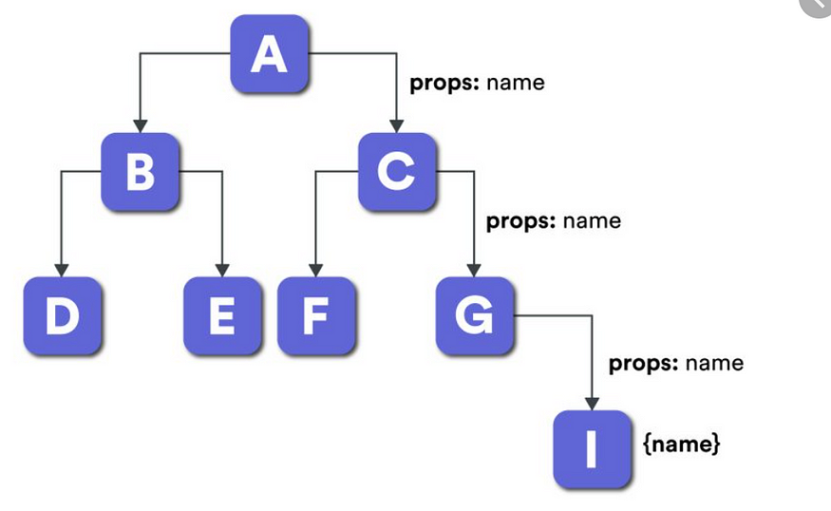

Slide 53
Context API is a way to share values (such as themes, user authentication status, etc.) between components without having to pass props through every level of the component tree. useContext hook allows us to use context API for state management for small applications.

Slide 54
First of all we will create a context
import { createContext } from 'react';
export const counterContext = createContext(0)

Slide 55
Then we will wrap all component where we need to get the value inside Context Provider.
import { counterContext } from './context/context';
<counterContext.Provider value={count}>
<Header count={count} />
<h3>Counter is: {count}</h3>
<button onClick={() => setCount(count + 1)}>Increment</button>
</counterContext.Provider>

Slide 56
Now you can use the `useContext` hook to access the context value in any component within the `MyContext.Provider` boundary.
import React, {useContext} from 'react'
import { counterContext } from '../context/context'
const Footer = () => {
const counter = useContext(counterContext);
return (
<div>
This is a footer show counter {counter}
</div>
)
}

Slide 57
Custom Hooks

Slide 58
Custom hooks are re-usable functions to share logic between components without duplicating.
It follows DRY Principles.
We usually use “use” before custom hooks. React does not enforce to write this but it is a standard because if we will not write like this other coders won’t be able to know it is a simple component or it is containing the hook inside it.

Slide 59
useCounter.js:
import {useState} from 'react’
const useCounter = (initialValue = 0) => {
const [count, setCount] = useState(initialValue);
const increment = () => setCount(count + 1);
const decrement = () => setCount(count - 1);
const reset = () => setCount(initialValue);
return { count, increment, decrement, reset }
}
export default useCounter

Slide 60
Counter.js
import useCounter from "../useCounter";
const {count, increment, decrement, reset} = useCounter(0);
return (
<div>
<h3>Counter is: {count}</h3>
<button onClick={increment}>INC</button>
<button onClick={decrement}>DEC</button>
<button onClick={reset}>reset</button>
</div>
)

Slide 61
React Router

Slide 62
React Router is a popular library for handling navigation and routing in React applications.
It enables you to create single-page applications (SPAs) where the content changes dynamically without the need for a full page reload.
React Router provides a set of components that can be used to define the navigation structure of your application.

Slide 63
React Redux

Slide 64
Redux is an open-source JavaScript library for managing the state of an application. It allows React components to read data from a Redux Store, and dispatch Actions to the Store to update data.
Choose Redux for complex, large-scale applications where you need a predictable state container, advanced debugging tools, and middleware support.
Choose the Context API for simpler, smaller applications where you want to avoid prop drilling and prefer a straightforward, built-in solution without additional dependencies.

Slide 65
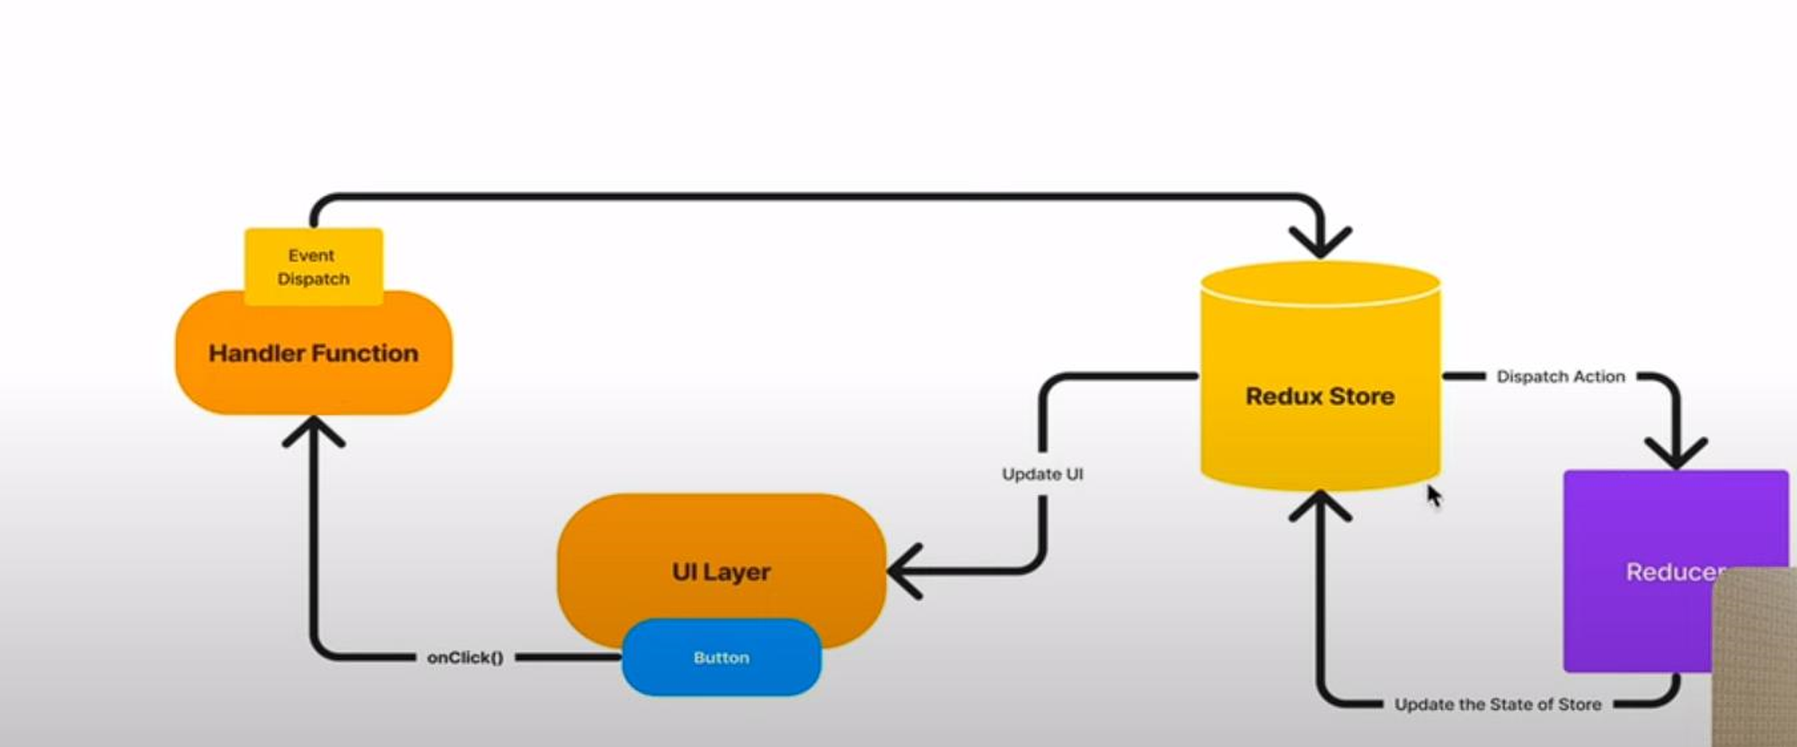

Slide 66
UI Layer: In a Redux application, the UI Layer consists of React components that interact with the Redux store to display data and dispatch actions.
Handler Function: In Redux, handler functions manage user interactions and dispatch actions to the store.
Redux Store: It holds the state tree and provides methods to access state, dispatch actions, and register listeners.
Reducers: Reducers are pure functions that specify how the state changes in response to actions. They take the current state and an action as arguments and return a new state.

Slide 67
Thanks!

